Slide 1
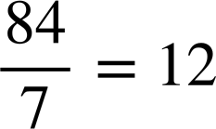
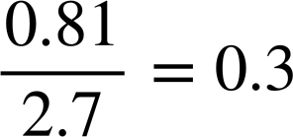
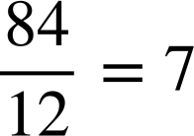
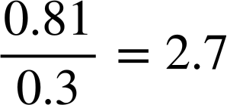
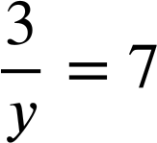
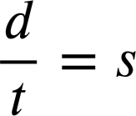
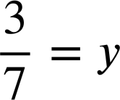
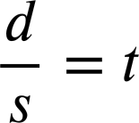
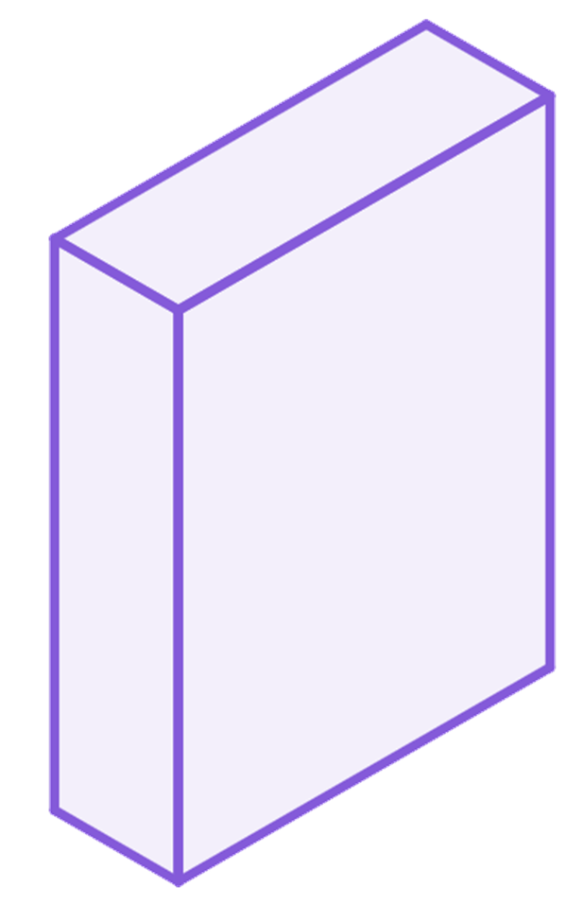
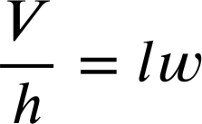
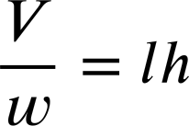
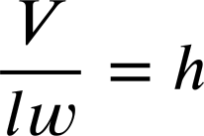
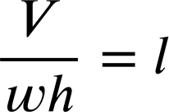
Multiplicative relationships between terms
Task A: The structure of multiplicative relationships
1) Write the family of rearrangements for the below equations.
a)
b)
12 × 7 = 84
0.3 × 2.7 = 0.81
7 × 12 = 84
2.7 × 0.3 = 0.81
c)
d)
7 × y = 3
d = s × t
y × 7 = 3
d = t × s
2) The volume of a cuboid can be calculated as ‘length × width × height’
Fill in the missing parts of these rearrangements.
V = lwh
h
V, the product of the original multiplicative relationship remained the numerator.
w
l

Slide 2
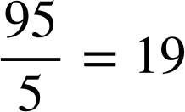
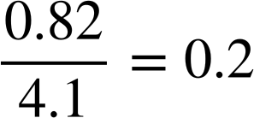
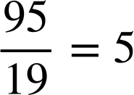
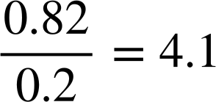














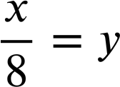
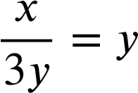
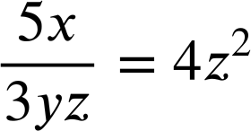
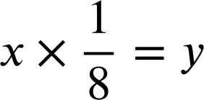
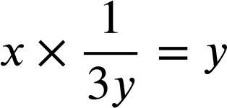
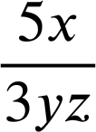
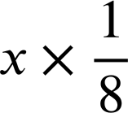
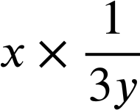
Multiplicative relationships between terms
Task B: Rearranging multiplicative relationships
1) Write the family of rearrangements for the below equations.
a)
b)
19 × 5 = 95
0.2 × 4.1 = 0.82
5 × 19 = 95
4.1 × 0.2 = 0.82
c)
d)
7 × y = 56
P = F × A
y × 7 = 56
P = A × F
2) Lucas is rearranging equations.
I just ‘swap positions’ in the equation.
In each case decide if Lucas is correct and write a sentence to justify your decision.
a)
Both are rearrangements of 8 × 9 = 72 where 72 is the product.
can swap to
b)
Both are rearrangements of bh = 5 where 5 is the product.
can swap to
c)
One is a rearrangement of 2x = 13 and the other is a rearrangement of 13x = 2
can swap to
3) Rearrange each equation into the form a × b = c
a)
b)
c)
× 3yz = 4z² × 3yz
× 8 = y × 8
× 3y = y × 3y
5x = 12yz³
x = 8y
x = 3y²
Mathematics in Education and Industry
v2.3

